Slide 1
Supply Chain Analysis
Name : Krishna Mohan B
Student ID: STU67c74640ed4b11741112896
College Name: Amity University Online (Passed Out)

Slide 2
Problem Statement of Supply Chain Analysis
Organizations possess an enormous amount of operational data on their modern supply chains, including all of their procurement, manufacturing, inventory, and shipping information, but their data is dispersed and fragmented. Because their data is separate, it results in inventory stockouts and surpluses, unreliably estimated demand, unnecessary shipping and manufacturing expenses, postponed lead times, and unmanaged supply chain risk. To alleviate and avoid these obstacles, organizations must apply an all-in-one analytical perspective, as it eliminates supply chain bottlenecks, decreases company costs, and scales for high-quality products.

Slide 3
Project Description of Supply Chain Analysis
End to End Supply Chain Data Analytics & Optimization Platform Ingestion, process and visualize key operational metrics from raw procurement up until last mile delivery. Use machine learning models, exploratory data analysis and interactive dashboard to find cost components, predict inventory outs, score vendors, optimizing routes and more. We are turning row operational values to actionable insights to improve your day-to-day, increase efficiencies and lower costs.
Dataset Description
The dataset encompasses key metrics covering four critical dimensions of the supply chain lifecycle:
Product & Commercial Metrics: Product type, SKU, Price, Availability, Number of products sold, Revenue generated, Customer demographics.
Inventory & Order Logistics: Stock levels, Lead times, Order quantities, Shipping times, Shipping carriers, Shipping costs.
Supplier & Manufacturing Data: Supplier name, Location, Lead time (supplier), Production volumes, Manufacturing lead time, Manufacturing costs.
Quality & Logistics Management: Inspection results, Defect rates, Transportation modes, Routes, Costs.

Slide 4
End users of this Project
Supply Chain Manager – to get end to end visibility; to understand what processes and procedures are creating performance bottlenecks and what is impacting velocity; to establish trends etc.;
Procurement and Purchasing Manager – to ascertain supplier reliability and on-time delivery; to negotiate prices with vendors taking into consideration manufacturing lead time and defect rate information;
Logistics and Distribution Manager - to manage modes of transport, choice of routing, transport cost and provider performance;
Quality assurance personnel - to analyze quality results and respond to significant changes in quality trends or increased defect rates in the factory;
Inventory Control Specialist – to avoid stock-outs and to avoid overstocking by correctly tracking lead time and quantity of order;

Slide 5
Technologies Used In this Project
Hardware Requirements
The hardware requirements for performing the Supply Chain Analysis are:
RAM – 8.00 GB
Operating System – Windows 11
Processor – Intel(R) Core(TM) i3-1115g4
Processor speed – 3.00 GHz
Software Requirements
The software requirements for performing the Supply Chain Analysis are:
Programming Language – Python
Development Environment / IDE – Jupyter Notebook
Data Analysis Libraries – Pandas, NumPy
Data Visualization Libraries – Matplotlib, Seaborn
Dataset Format – CSV

Slide 6
Data Cleaning Process

Slide 7
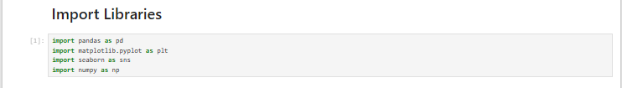

Slide 8
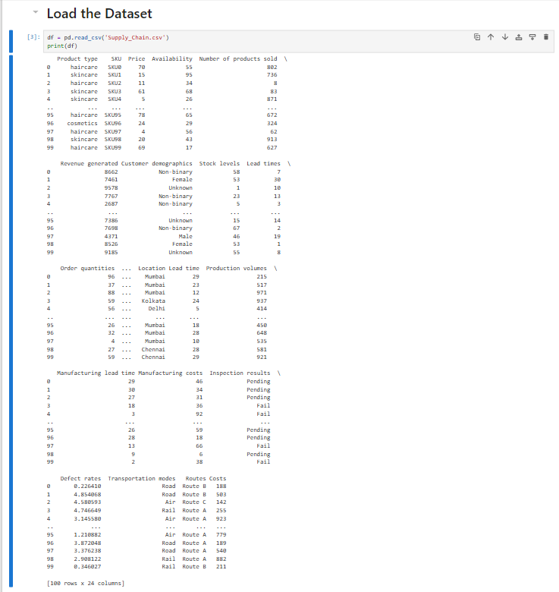

Slide 9
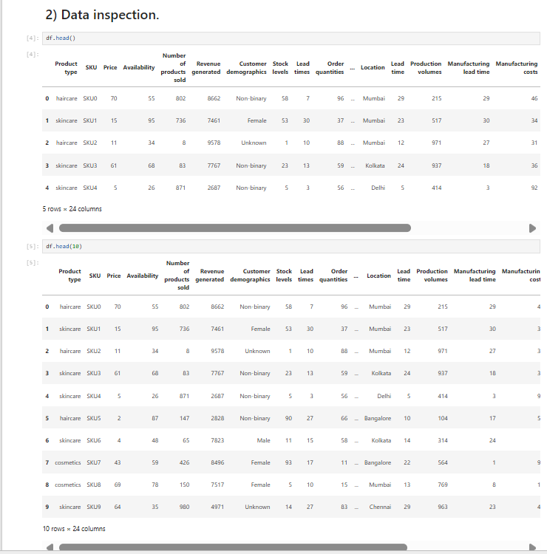

Slide 10
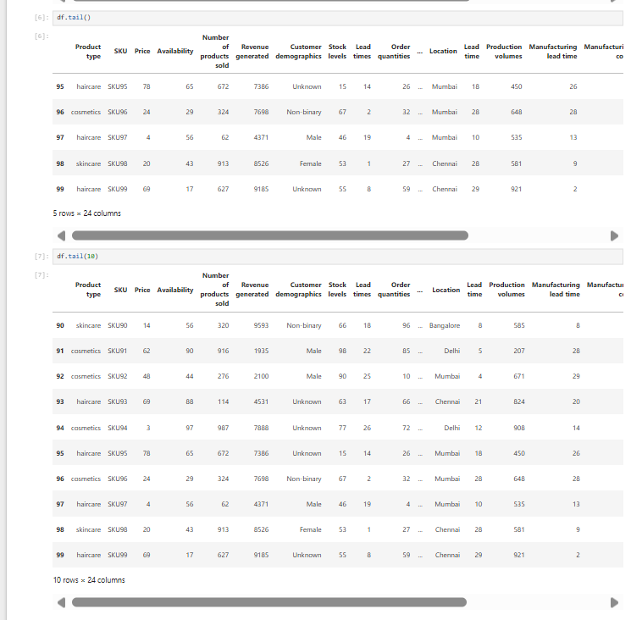

Slide 11
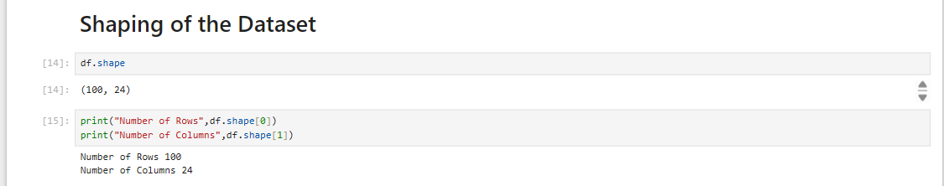

Slide 12
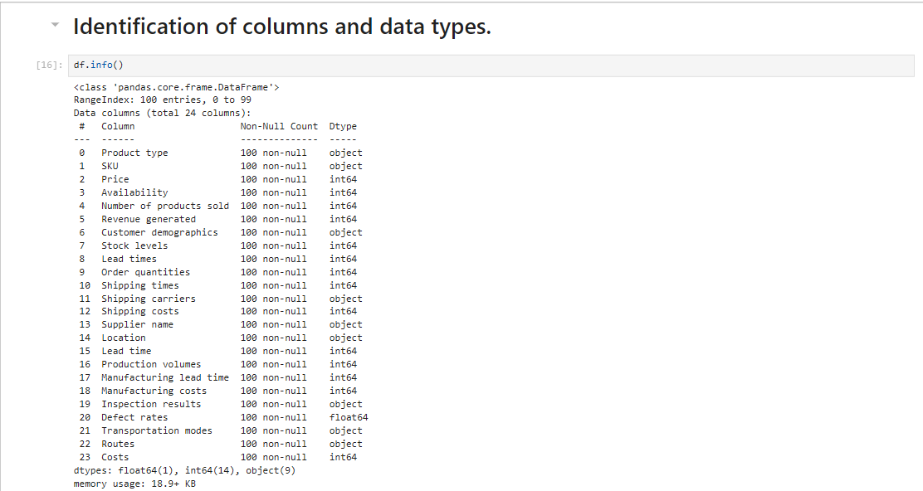

Slide 13
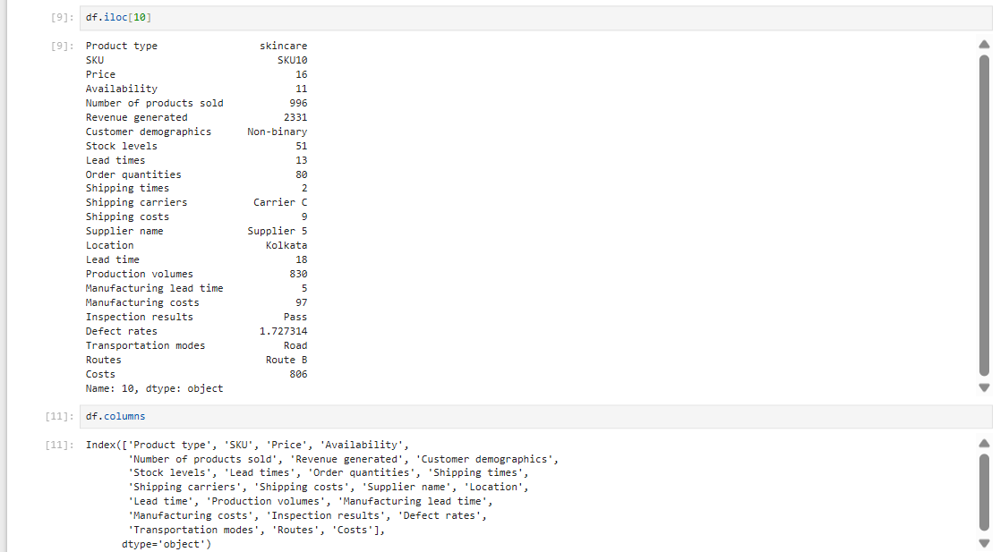

Slide 14
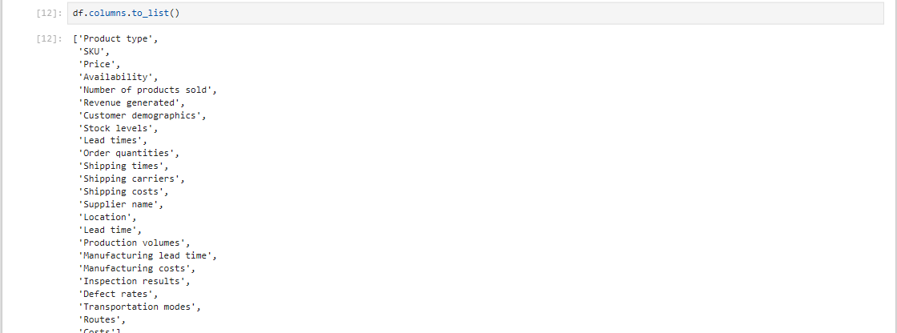

Slide 15
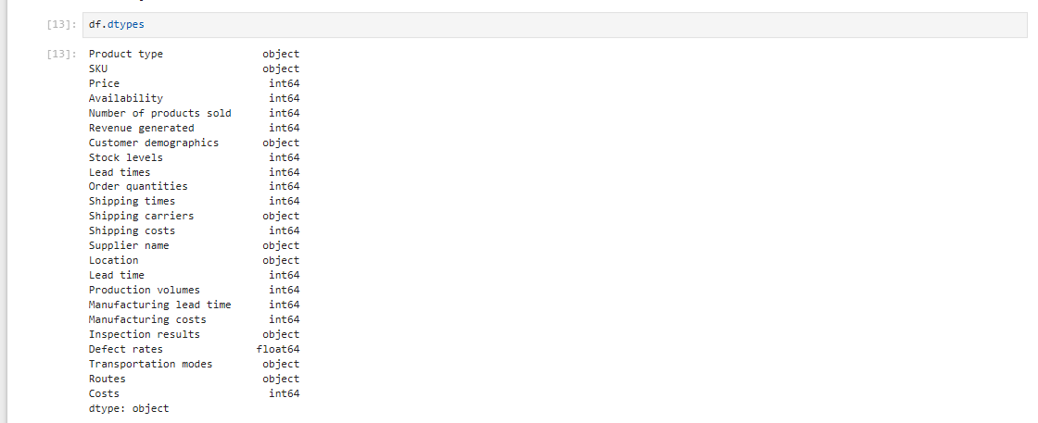

Slide 16
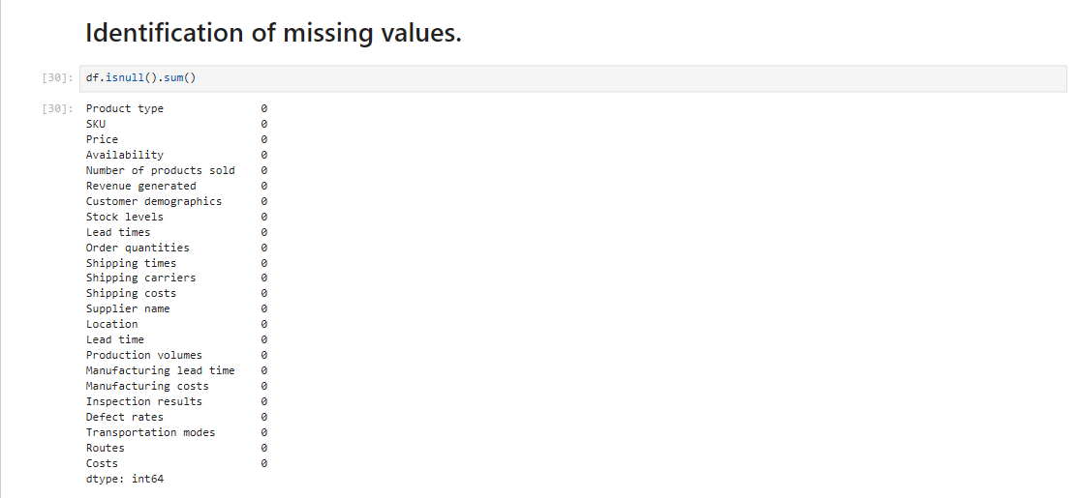

Slide 17
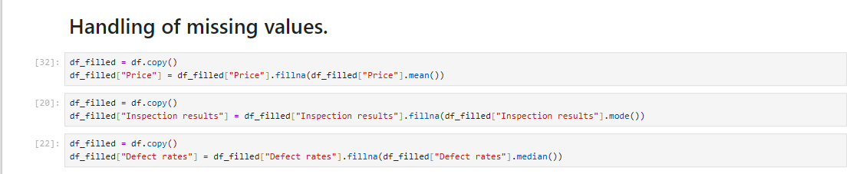

Slide 18
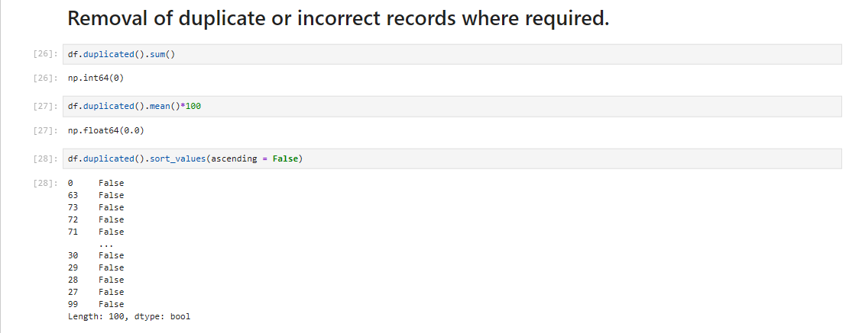

Slide 19
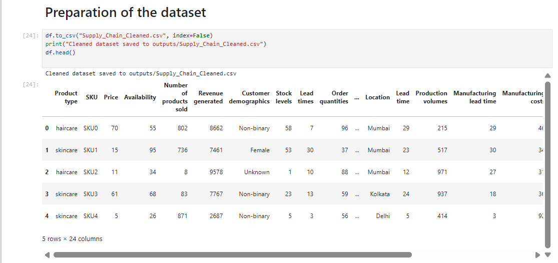

Slide 20
Exploratory Data Analysis (EDA)

Slide 21
What is the Exploratory Data Analysis (EDA)
Exploratory Data Analysis (EDA)is a vital phase in data analysis involving the examination and visualization of data to uncover patterns ,trends, and insights.in the context of an Airbnb data analysis project, EDA allows researchers to gain a Comprehensive understanding of the dataset's characteristics, distribution and relationships between variables. Through techniques such as summary stastics, data visualization ,and correlation analysis, EDA sets the stage for further investigation and hypothesis testing, uiding subsequent analytical decisions.

Slide 22
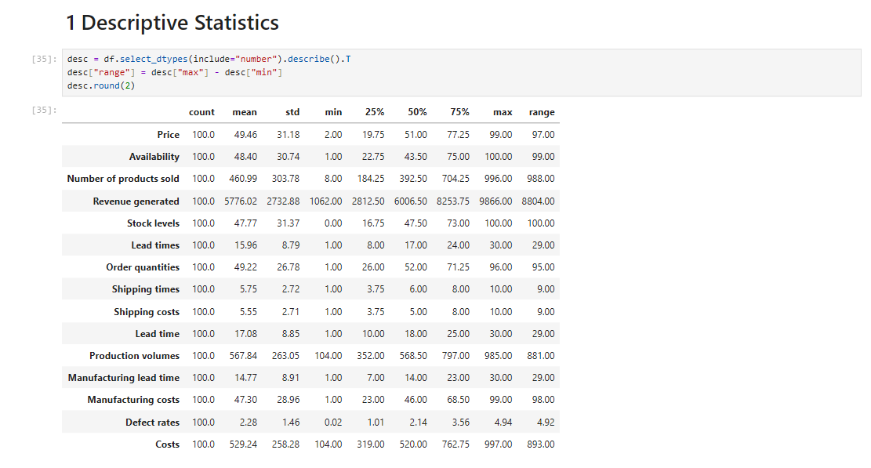

Slide 23
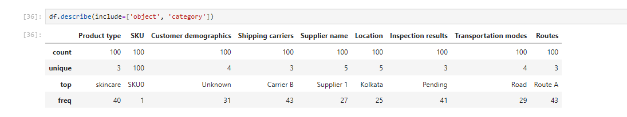

Slide 24
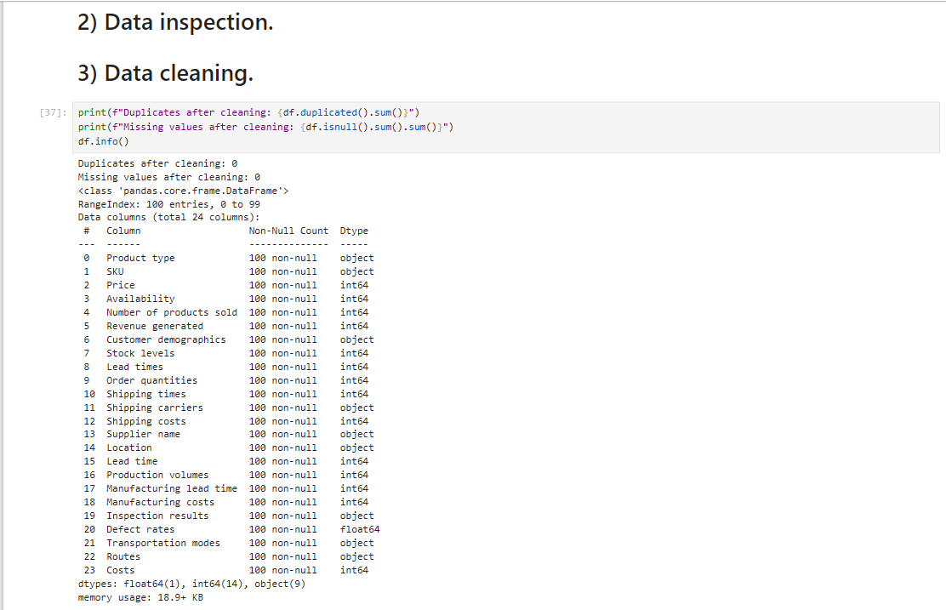

Slide 25
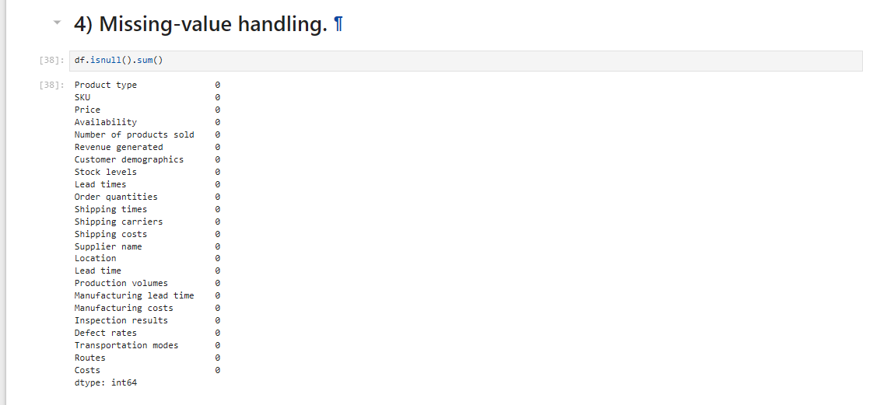

Slide 26
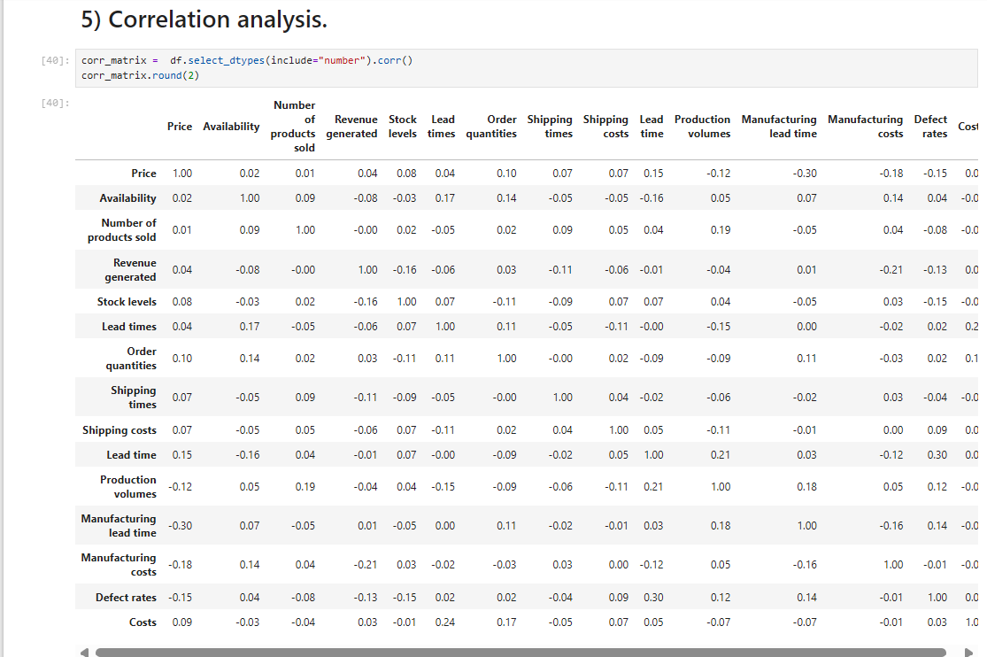

Slide 27
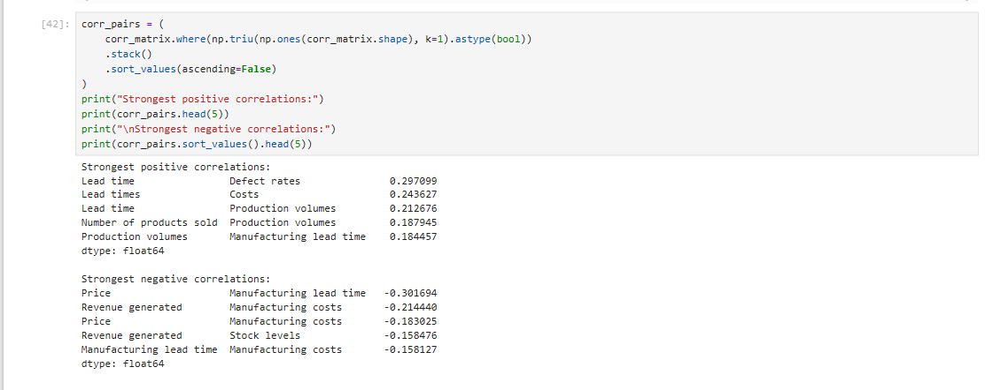

Slide 28
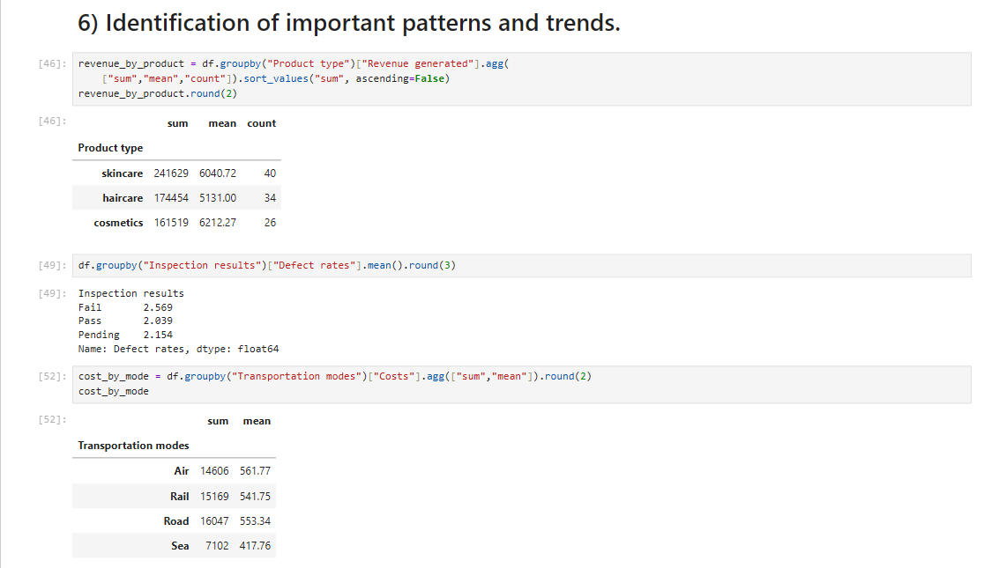

Slide 29
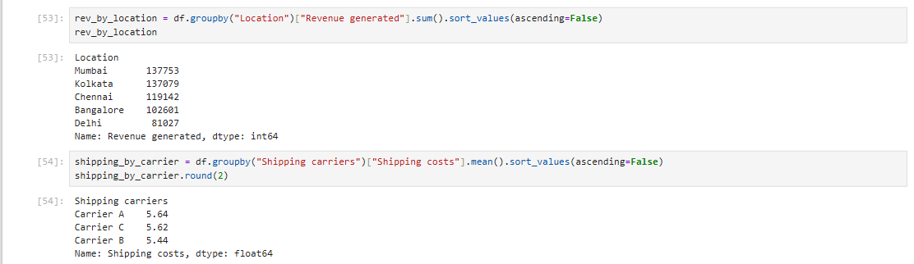

Slide 30
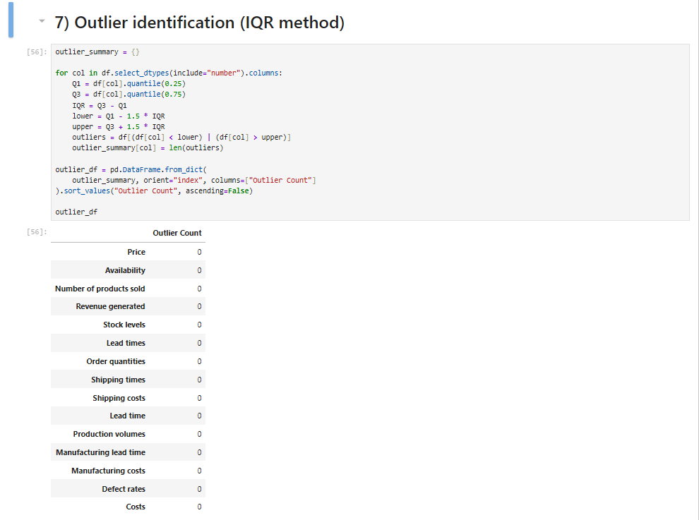

Slide 31
Explanation of our findings
1.The dataset contains 100 SKUs across 3 product categories (haircare, skincare, cosmetics) with no missing values or duplicates after cleaning.
2. Revenue generated shows wide variation across products, indicating uneven sales performance across the portfolio.
3. Correlation analysis shows most numeric supply chain metrics are only weakly correlated with each other — pricing, sales volume, manufacturing, and shipping metrics largely vary independently, suggesting revenue is driven by a mix of factors rather than any single lever.
4. Several numeric columns (e.g. Defect rates, Costs, Revenue generated) contain outlier values, indicating a few SKUs/orders with unusually high cost, defect, or revenue figures that merit special attention.
5. Costs and shipping performance vary meaningfully by transportation mode and carrier, suggesting opportunities for logistics optimization.

Slide 32
Data Virtualization

Slide 33
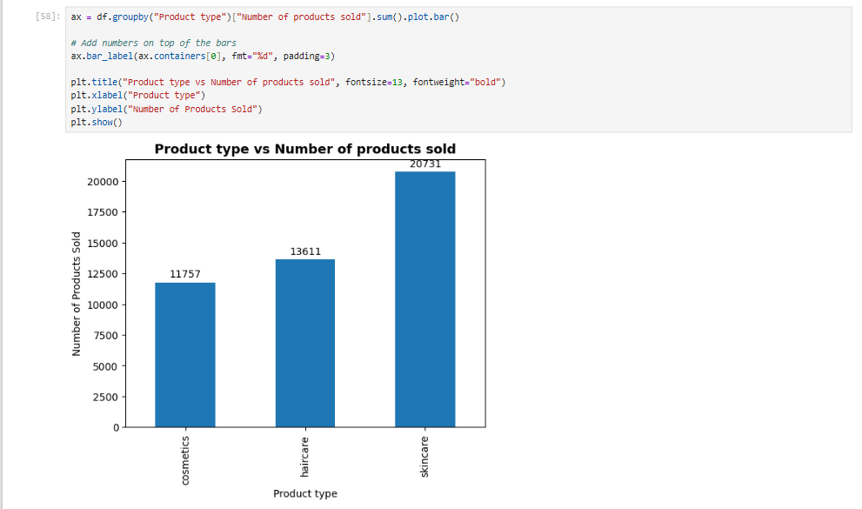

Slide 34
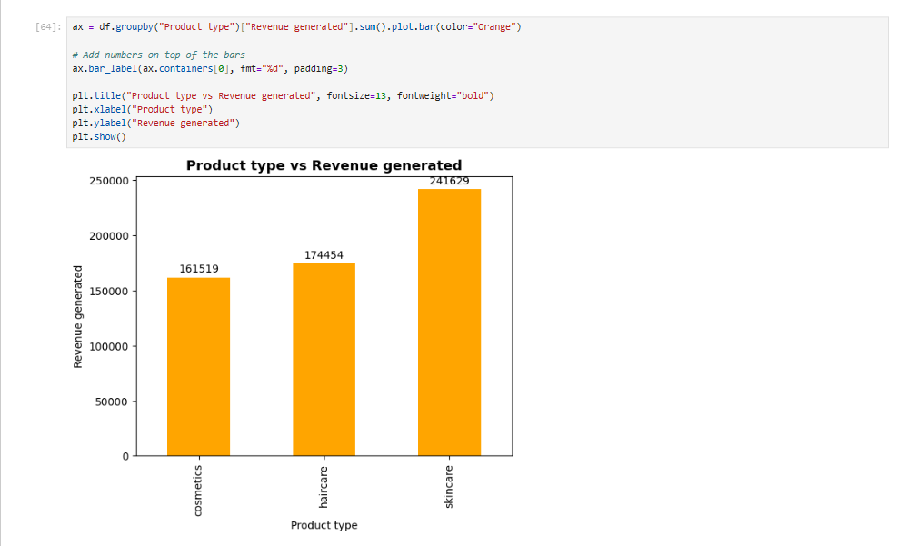

Slide 35
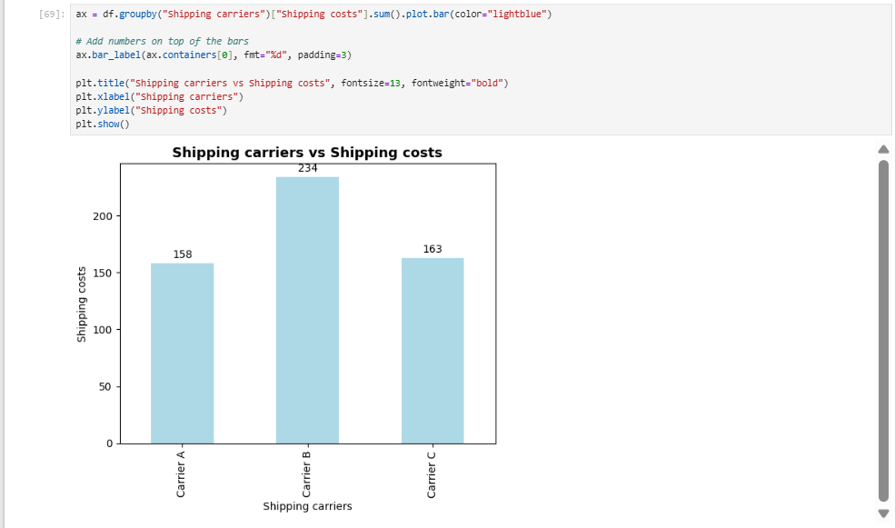

Slide 36
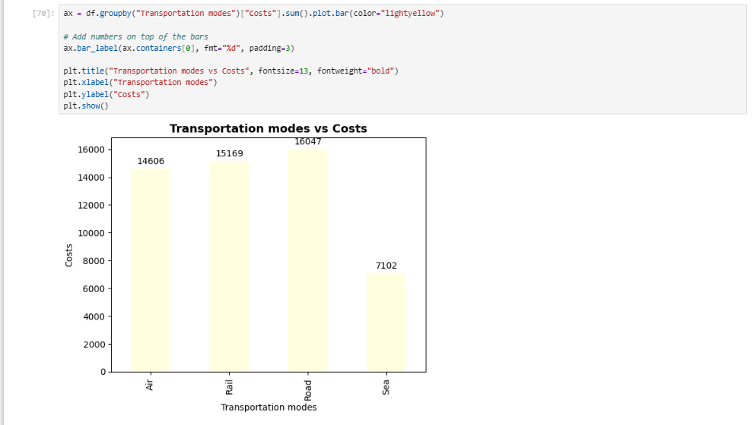

Slide 37
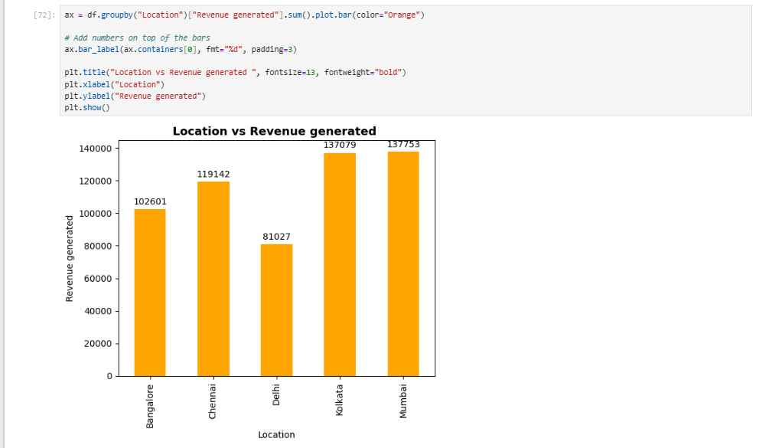

Slide 38
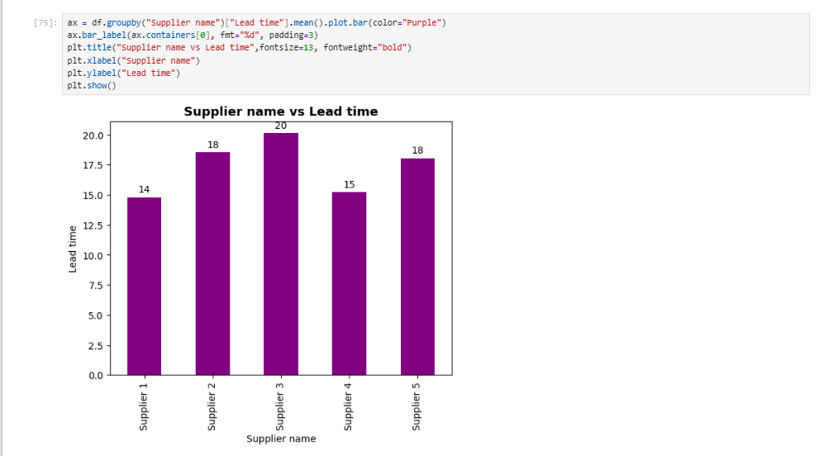

Slide 39
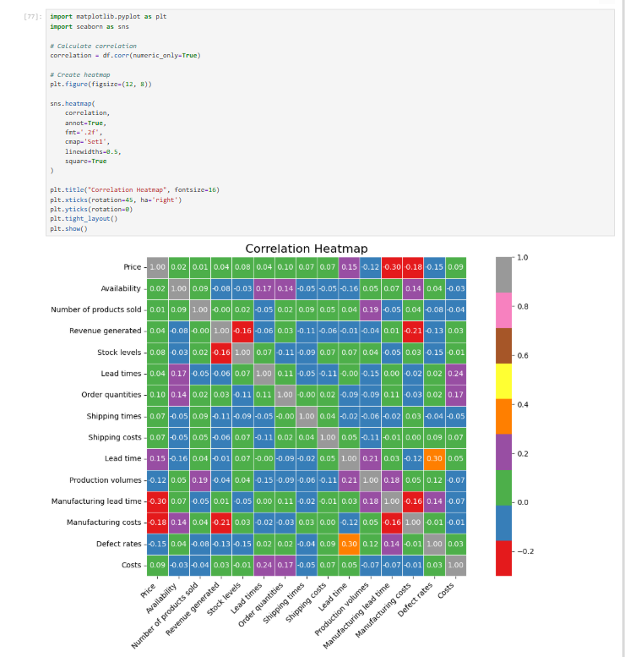

Slide 40
Power BI

Slide 41
What is Power BI ?
Power BI is Microsoft's business analytics and data visualization platform that turns raw, disconnected data into interactive, easy-to-understand dashboards and reports

Slide 42
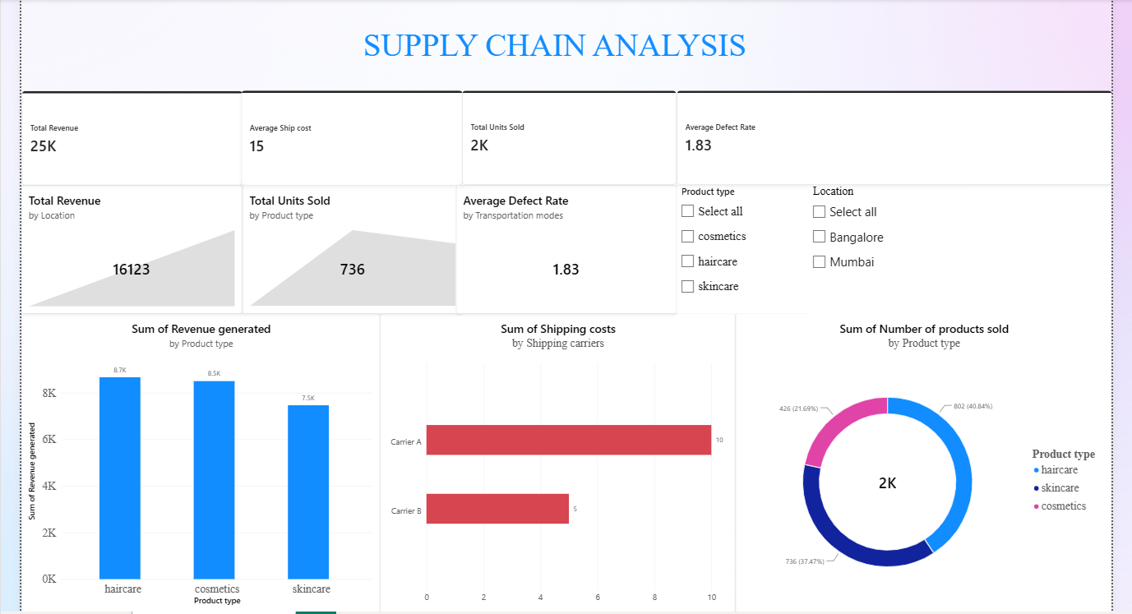

Slide 43
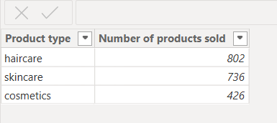
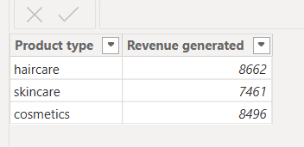
Table View

Slide 44
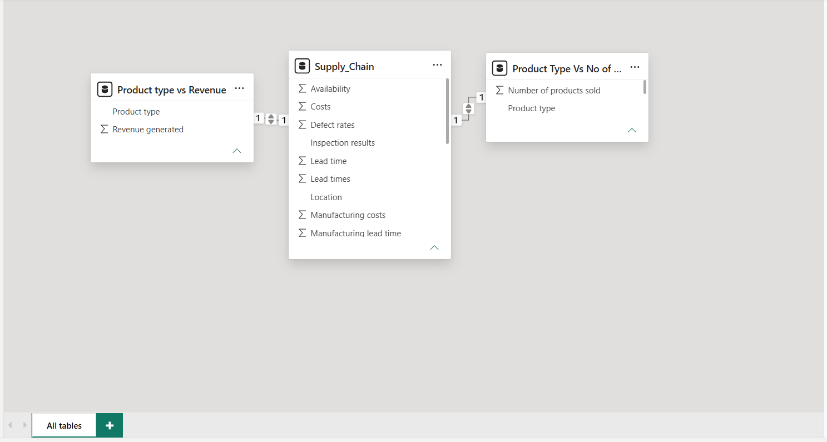
Model View

Slide 45
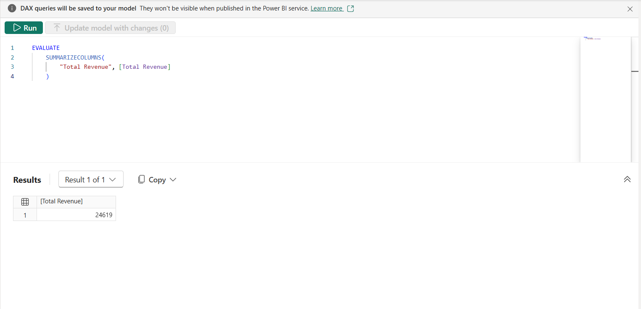
DAX View
Total Revenue = SUM(Supply_Chain[Revenue generated])

Slide 46
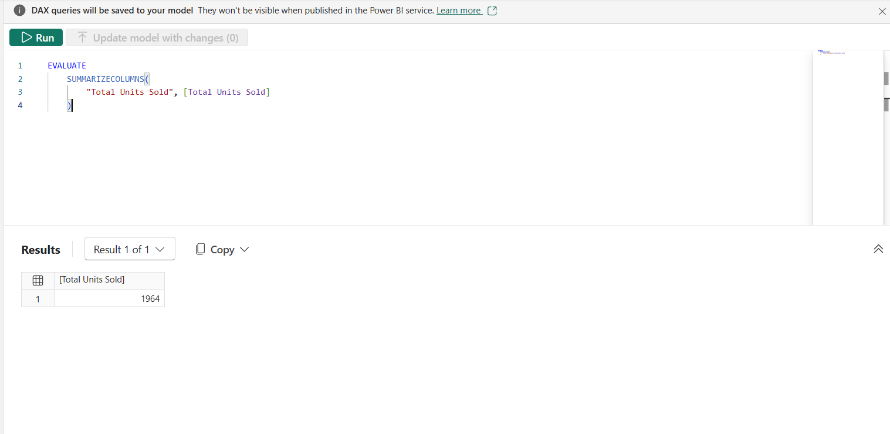
Total Units Sold = SUM(Supply_Chain[Number of products sold])

Slide 47
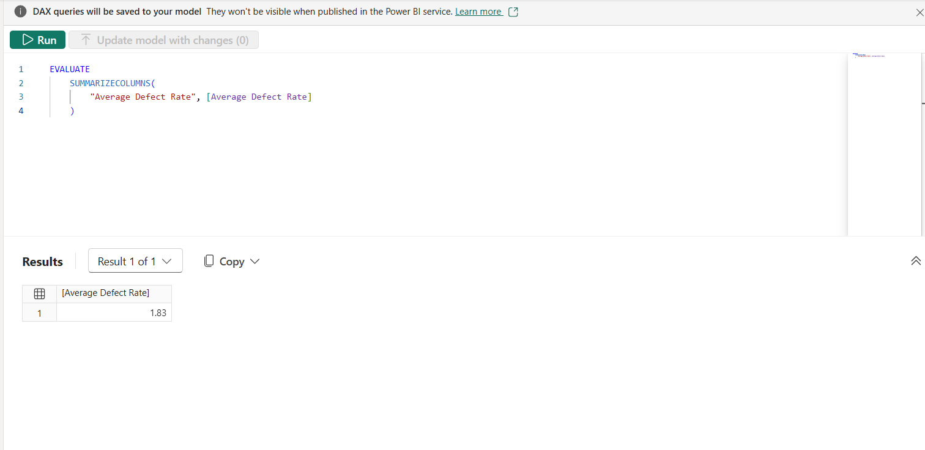
Average Defect Rate = AVERAGE(Supply_Chain[Defect rates])

Slide 48
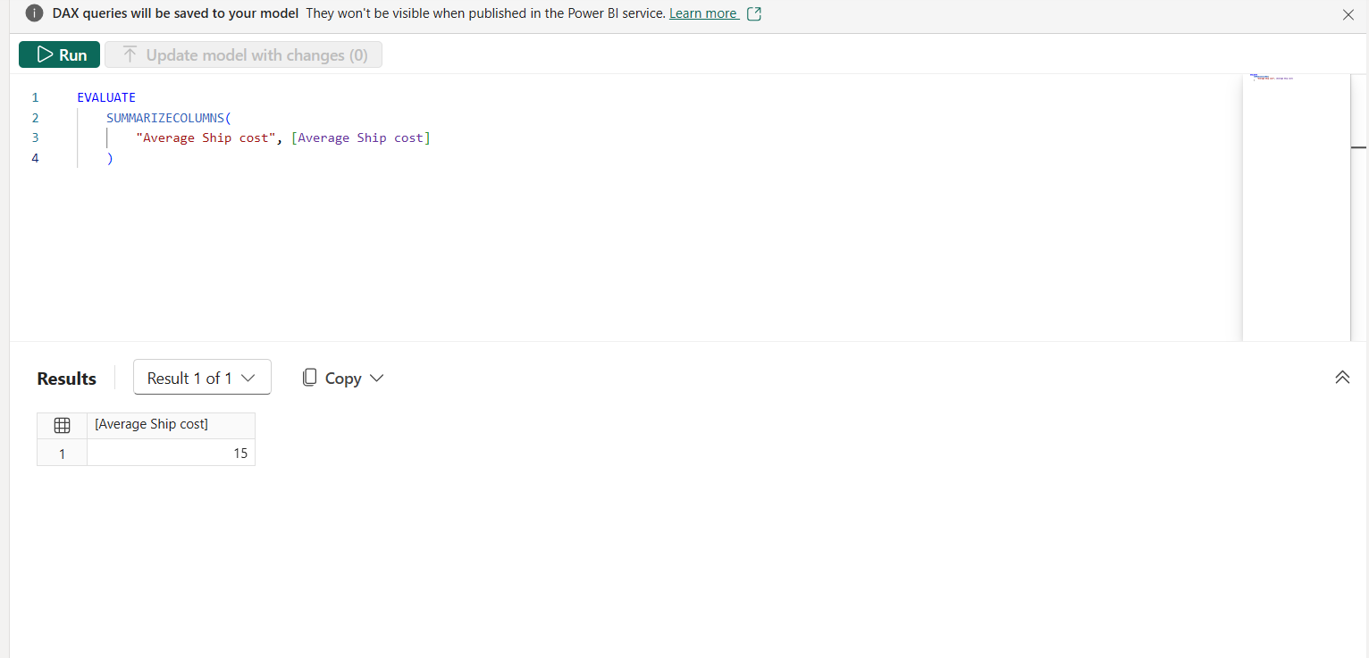
Average Ship cost = SUM(Supply_Chain[Shipping costs])

Slide 49
Business Insights and Recommendations

Slide 50
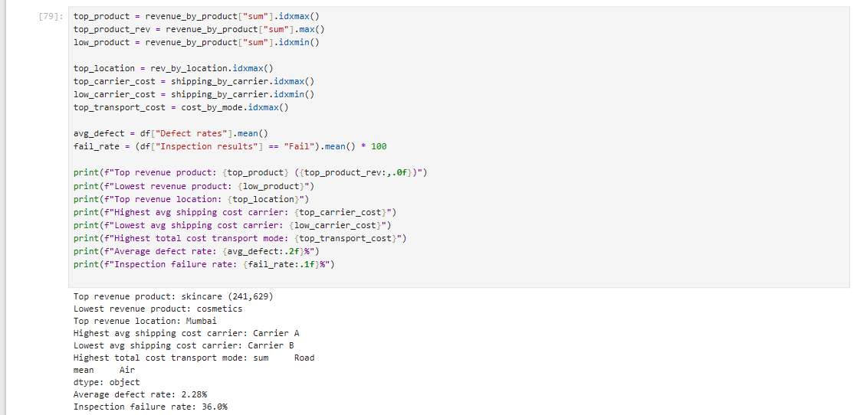

Slide 51
Business Insights
1. Top-performing product category : skincare generates the highest total revenue, while cosmetics lags behind. Product mix and marketing focus should lean toward high performers.
2. Regional revenue concentration: Mumbai contributes the highest total revenue among all locations, indicating a geographically concentrated demand/supply base.
3. Shipping carrier cost gap: Carrier A has the highest average shipping cost, while `Carrier B` is the most cost-efficient carrier. Renegotiating rates or shifting volume toward cheaper, reliable carriers could reduce logistics spend.
4. Transportation mode cost impact :Road contributes the largest share of total logistics costs, suggesting a review of route/mode mix could unlock savings (e.g., shifting non-urgent shipments to cheaper modes).
5. Quality / defect risk :The average defect rate across all SKUs is around 2.3%, and roughly 36% of inspected batches failed quality inspection. Suppliers/SKUs with high defect rates should be flagged for quality audits
6. Revenue vs. sales volume relationship: Revenue does not scale purely linearly with units sold across product types, implying pricing strategy differences materially affect revenue outcomes.

Slide 52
Business Recommendations
R1. Reallocate marketing and inventory investment toward the strongest revenue-generating category (skincare), while investigating and improving underperformance in cosmetics.
R2. Consolidate shipments with lower-cost, high-performing carriers (e.g., Carrier B) and renegotiate contracts with higher-cost carriers such as Carrier A to reduce overall shipping expenditure.
R3. Implement stricter supplier quality controls / audits for SKUs and suppliers with above-average defect rates to reduce failed inspections and associated rework/returns costs.-
R4. Optimize the transportation mode mix — shift a portion of volume currently on Road to lower-cost alternatives where delivery-time requirements allow, to reduce total logistics costs without harming service levels.

Slide 53
Future Scope
IoT Real Time Integration : Integrate with a shipping carriers' GPS data, as well as with their telemetry data for real-time route optimization and delivery visibility.
Automatic Demand Forecasting : Utilize sophisticated time-series modeling techniques (ARIMA, Prophet, LSTM etc.), and customer demographic data to predict sales velocity.
Prescriptive Replenishment Planning : Proactively determine reorder points and auto generate purchase orders based on real-time stock levels, and vendor lead-times.
Sustainability and carbon footprint tracking : Measure and track emissions per mile for each transit mode and route, as a contribution to the green supply chain.

Slide 54
Conclusion
By uniting product economics, inventory logistics, manufacturing parameters, and quality metrics into a single analytical model, this project addresses the fundamental inefficiencies of fragmented supply chain management. The unified framework empowers data-driven decision-making, significantly reduces lead times and defect rates, minimizes logistics and manufacturing costs, and builds a resilient, customer-centric supply ecosystem.

Slide 55
Thank You

